Slide 1

EyeGuard-XAI: A Reliability-Aware and Explainable Multi-Disease Retinal Screening System with Dual-Interface Design and Educational Chatbot Support
Muhammed Usman (22P-9071)
Talha Hanif (22P-9051)
Project Supervisor
Mr. Muhammad Zulqarnain

Slide 2
Introduction
Retinal diseases are a leading cause of preventable blindness worldwide.
Early and accurate detection is critical to prevent permanent vision loss.
Reliable and transparent screening systems are essential for safe clinical use.
A retinal screening system that provides accurate, uncertainty-aware, and explainable predictions.
Supports safer clinical decisions and improves patient awareness through structured risk-based outputs.

Slide 3
Motivation
AI screening systems remain overconfident and uncalibrated.
No uncertainty awareness may lead to unsafe decisions.
Limited explainability reduces clinical trust.

Slide 4
Problem Statement
Existing retinal screening models achieve high accuracy but often generate overconfident and poorly calibrated predictions without uncertainty estimation or explainability. This limits clinical trust, safety, and practical usability. Therefore, a reliability-aware and explainable retinal screening framework with structured dual-interface output is required.

Slide 5
Solution
Develop a multi-disease retinal screening system.
Integrate uncertainty estimation to measure prediction confidence.
Apply probability calibration to reduce overconfidence.
Generate explainability heatmaps for visual interpretation.
Design a dual-interface system (Doctor View & Patient View).
Implement an educational chatbot for symptom and prevention guidance.

Slide 6
Scope of the project
Multi-disease retinal screening with severity grading.
Uncertainty estimation for prediction reliability.
Probability calibration to reduce overconfidence.
Explainability heatmaps for visual interpretation.
Dual-interface design (Doctor & Patient view).
Rule-based educational chatbot for awareness and prevention guidance.

Slide 7
Goals
Develop a multi-disease retinal screening model with severity grading.
Incorporate uncertainty estimation to assess prediction reliability.
Improve probability calibration using Expected Calibration Error (ECE).
Integrate explainable AI for visual interpretation of predictions.
Design a structured dual-interface system for doctors and patients.
Implement a safe and controlled educational chatbot for awareness support.

Slide 8
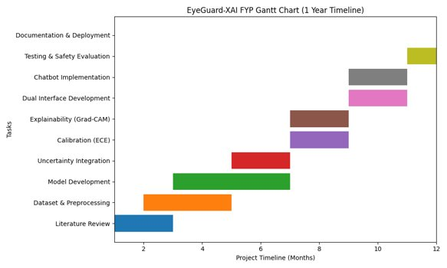
Objectives
Gantt Chart

Slide 9
Expected Result
Multi-disease detection with severity grading.
Calibrated probabilities with uncertainty scores.
Visual explainability using heatmaps.
Detailed Doctor View with structured clinical output.
Simplified Patient View with risk-based results.
Educational chatbot for awareness support.
Reliable and trustworthy screening assistance system.

Slide 10
Team Work
Shared involvement in requirements analysis and system design.
Collaborative model development and experimentation.
Even distribution of tasks: uncertainty, calibration, explainability, interface, and chatbot.
Joint testing, evaluation, and documentation.

Slide 11
References
Herrero-Tudela, María, et al. "An explainable deep-learning model to aid in the diagnosis of age related macular degeneration." European Medical and Biological Engineering Conference. Cham: Springer Nature Switzerland, 2024.
Lin, Xiling, et al. "Global, regional, and national burden and trend of diabetes in 195 countries and territories: an analysis from 1990 to 2025." Scientific reports 10.1 (2020): 14790.

